Slide 1
SMART ACCIDENT PREVENTION AND HELMET DETECTION
iSpark Internship – Mandatory Training Program
TEAM MEAMBERS:
HARSHIYA HASHIM | 1AM22AI014
KAYSAN MOHAMED ALFHAZ | 4DM22EC023
MOHAMMED CIYAF | 4DM22EC028
MOHAMMAD JASVEER | 4DM22EC027
PUJITHA P | 1V122ME006
SREYASREE R JOSHI | 1KS22CM050

Slide 2
INTRODUCTION
Road accidents are a major cause of injuries and fatalities, especially in two-wheeler riders.
Many accidents occur due to lack of helmet usage, rider fatigue, and loss of control.
Traditional safety systems act after an accident occurs, not before.
This project proposes a Smart Accident Prevention System that actively monitors rider behavior and prevents unsafe conditions.
The system integrates sensor-based monitoring and vision-based helmet detection to improve road safety.

Slide 3
PROBLEM STATEMENT
Riders often:
Do not wear helmets
Ride while drowsy or fatigued
Lose control due to sudden tilt or imbalance
Existing systems:
Do not enforce helmet usage
Lack real-time monitoring of rider condition
Do not provide early warnings
There is a need for a system that:
Prevents vehicle ignition without helmet
Detects unsafe riding conditions in real time
Warns the rider before accidents occur

Slide 4
GOALS AND OBJECTIVES
Primary Goal:
To design a smart safety system that reduces accident risk in two-wheelers.
Objectives:
Detect whether the rider is wearing a helmet using a camera module
Prevent ignition if no helmet is detected
Monitor rider drowsiness using an IR sensor
Detect sudden tilt or abnormal motion using MPU6050
Provide immediate alerts using buzzer and LED
Implement basic predictive logic to identify unsafe conditions

Slide 5
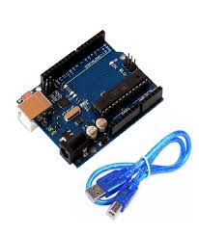
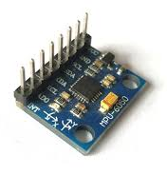
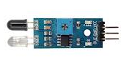
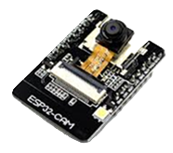
HARDWARE REQUIREMENTS
Arduino Uno (main controller)
MPU6050 (accelerometer + gyroscope for tilt detection)
IR Sensor (for drowsiness detection)
ESP32-CAM (for helmet detection)
Relay Module (for ignition control)
Buzzer (audio alert)
LED (visual indication)
Breadboard and jumper wires
Power supply (USB / battery)

Slide 6
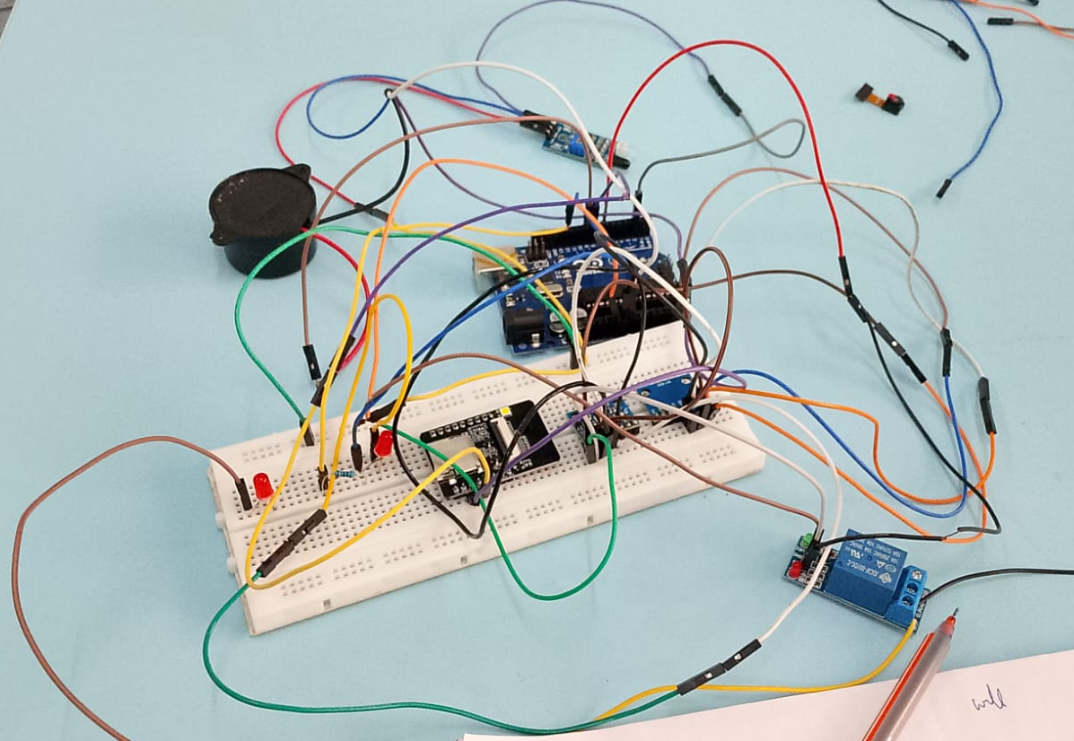
HARDWARE REQUIREMENTS

Slide 7
SOFTWARE REQUIREMENTS
Arduino IDE for programming microcontrollers
ESP32 board package (for ESP32-CAM support)
Embedded C / Arduino programming language
Serial Monitor for debugging and calibration
MPU6050 library for motion sensing
Wire (I2C) library for sensor communication

Slide 8
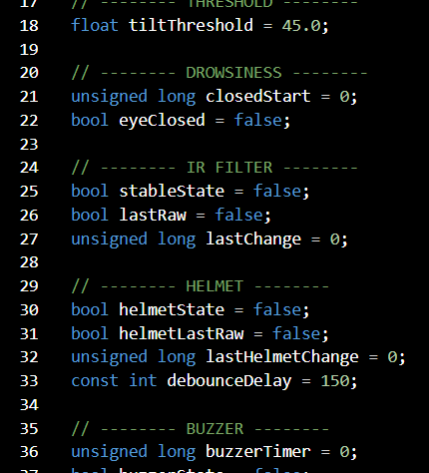
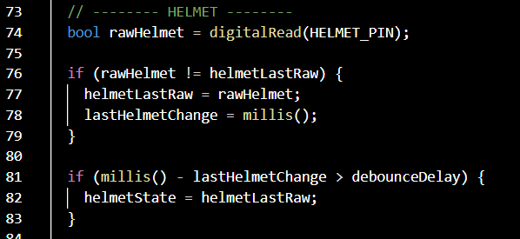
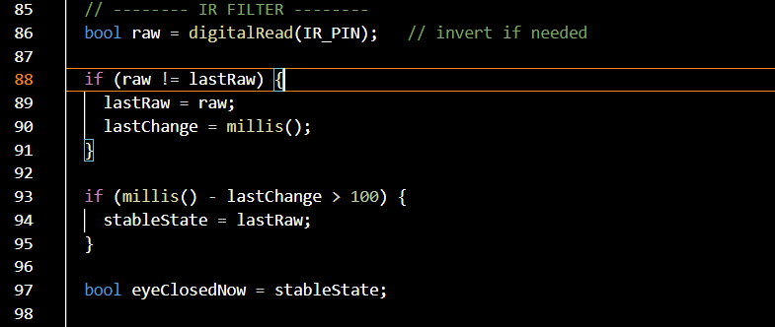
SOFTWARE REQUIREMENTS

Slide 9
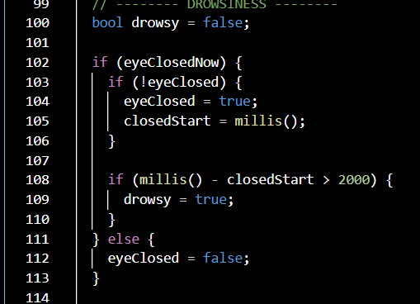
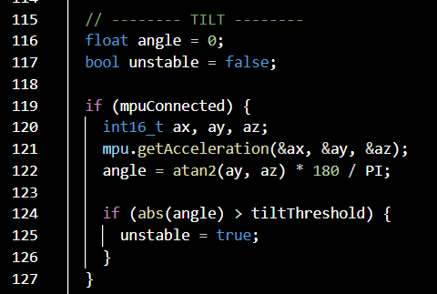
SOFTWARE REQUIREMENTS

Slide 10
METHODOLOGY
Step 1: Helmet Detection
ESP32-CAM processes visual input (or test mode signal)
Sends digital signal to Arduino:
HIGH → Helmet present
LOW → No helmet
Step 2: Drowsiness Detection
IR sensor detects eye closure using reflection
If eye remains closed for > 2 seconds → drowsiness detected
Signal is filtered to avoid noise and false triggers
Step 3: Motion/Tilt Detection
MPU6050 measures orientation and acceleration
Tilt angle calculated using trigonometric functions
If angle exceeds threshold → unstable condition

Slide 11
METHODOLOGY
Step 5: Output & Actuation
Relay controls ignition (ON/OFF)
Buzzer provides audio alerts:
Continuous → no helmet
Fast → accident/high risk
Slow → drowsiness
LED provides visual indication
Step 6: System Architecture
ESP32 → vision/input module
Arduino → processing & control unit
Relay → power switching unit
Sensors → real-time monitoring
Step 4: Signal Processing & Decision Logic
Arduino acts as central controller
Combines inputs from:
Helmet signal
IR sensor
MPU6050
Decision hierarchy:
No helmet → block ignition
High risk (drowsy + tilt) → emergency state
Tilt → accident detection
Drowsiness → warning
Safe → normal operation

Slide 12
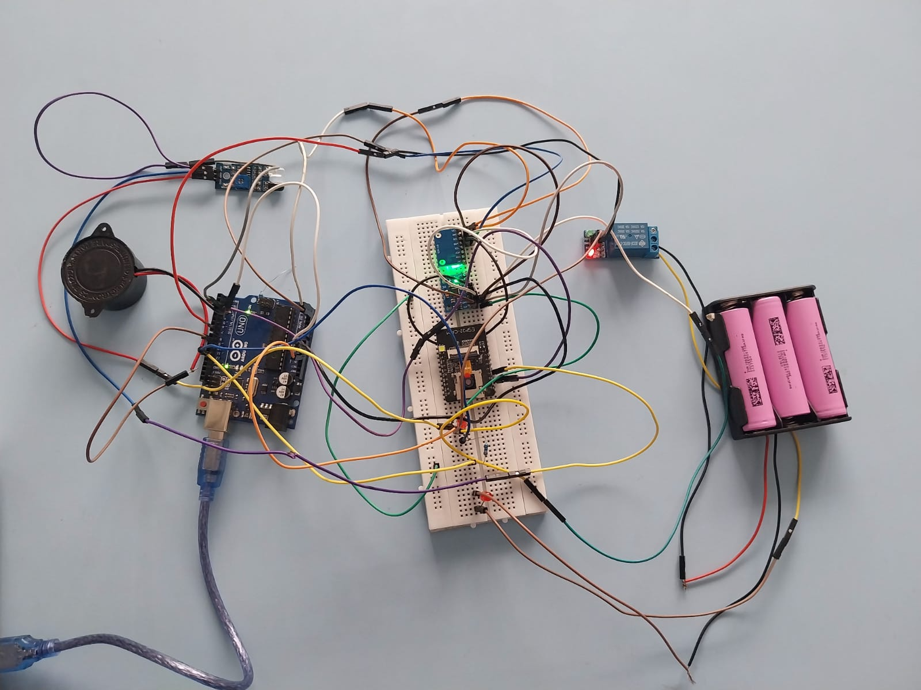
RESULT

Slide 13
FUTURE ENHANCEMENTS
Real-time AI-based helmet detection using ESP32-CAM
Integration of GPS for accident location tracking
GSM module for emergency alerts and messaging
Mobile application for monitoring rider status
Data logging for rider behavior analysis
Integration with smart helmets and IoT platforms
Machine learning models for predictive accident analysis

Slide 14
SYSTEM ADVANTAGES
Prevents unsafe riding conditions proactively
Low-cost and easily deployable
Real-time monitoring and response
Modular and scalable design
Enhances rider safety without complex infrastructure

Slide 15


